Slide 1




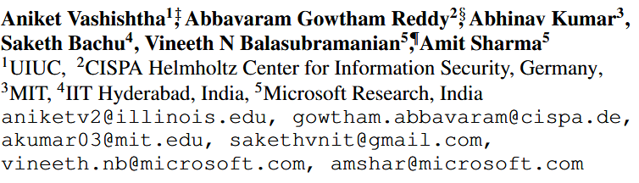



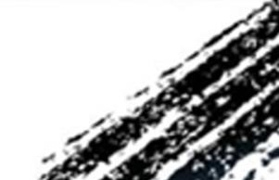

ATAI
Advanced Technique of Artificial Intelligence
ATAI
ChongqingUniversity _{AdvancedTechniqueof}
of Technology Artificial Intelligence
Chongqing University of
Technology
Chongqing University ^{ATAI}
_{of Technology} Advanced Techniqueof
Artificial Intelligence
Chongqing University of Technology
Chongqing University of Technology
Causal Order : The key to Leveraging Imperfect Experts in Causal Inference
Code : https://github.com/AniketVashishtha/Causal_Order_Imperfect_Experts
——ICLR_2025
Reported by Yuhang Jang
1

Slide 2
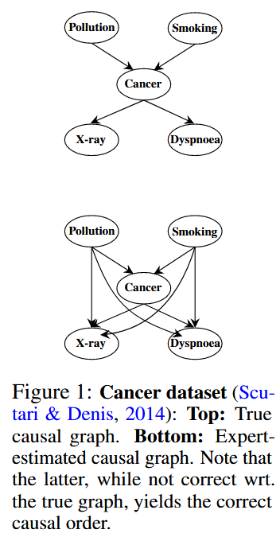
ATAI
Advanced Technique of Artificial Intelligence
ATAI
ChongqingUniversity _{AdvancedTechniqueof}
of Technology Artificial Intelligence
Chongqing University of
Technology
Chongqing University ^{ATAI}
_{of Technology} Advanced Techniqueof
Artificial Intelligence
Chongqing University of Technology
Chongqing University of Technology
Motivation
Large Language Models (LLMs) have been used as experts to infer causal graphs, often by repeatedly applying a pairwise prompt that asks about the causal relationship of each variable pair. However, such experts, including human domain experts, cannot distinguish between direct and indirect effects given a pairwise prompt. LLMs are imperfect experts and we find that pairwise prompts lead to multiple cycles.

Slide 3
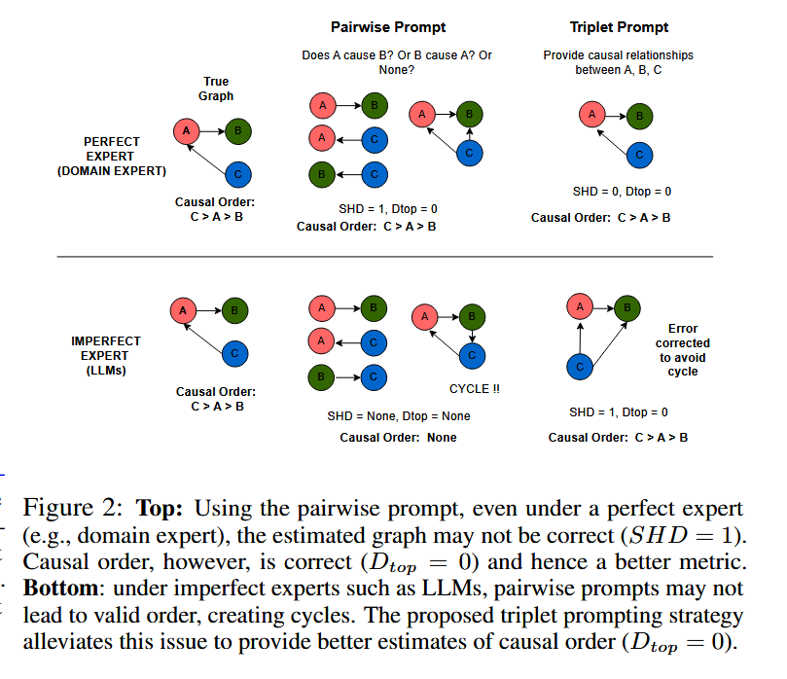
ATAI
Advanced Technique of Artificial Intelligence
ATAI
ChongqingUniversity _{AdvancedTechniqueof}
of Technology Artificial Intelligence
Chongqing University of
Technology
Chongqing University ^{ATAI}
_{of Technology} Advanced Techniqueof
Artificial Intelligence
Chongqing University of Technology
Chongqing University of Technology
Motivation
Large Language Models (LLMs) have been used as experts to infer causal graphs, often by repeatedly applying a pairwise prompt that asks about the causal relationship of each variable pair. However, such experts, including human domain experts, cannot distinguish between direct and indirect effects given a pairwise prompt. Therefore, instead of the graph, we propose that causal order be used as a more stable output interface for utilizing expert knowledge.
LLMs are imperfect experts and we find that pairwise prompts lead to multiple cycles.

Slide 4
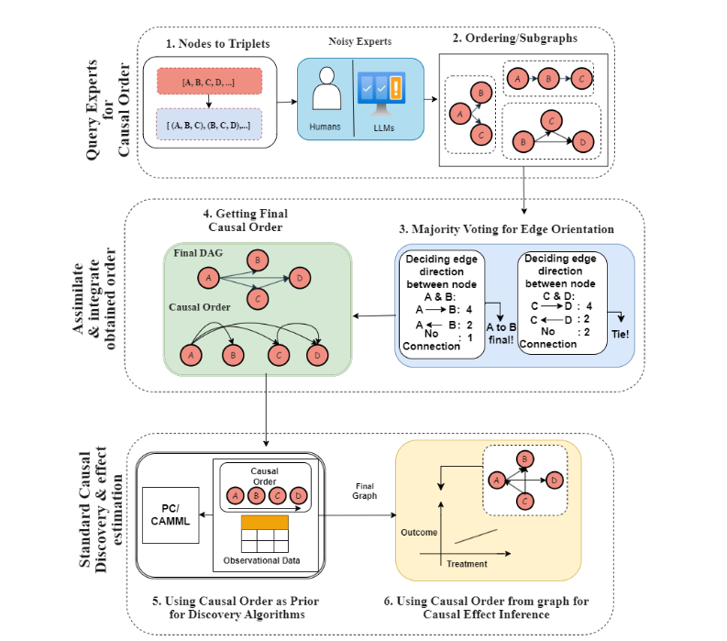
ATAI
Advanced Technique of Artificial Intelligence
ATAI
ChongqingUniversity _{AdvancedTechniqueof}
of Technology Artificial Intelligence
Chongqing University of
Technology
Chongqing University ^{ATAI}
_{of Technology} Advanced Techniqueof
Artificial Intelligence
Chongqing University of Technology
Chongqing University of Technology
Method

Slide 5
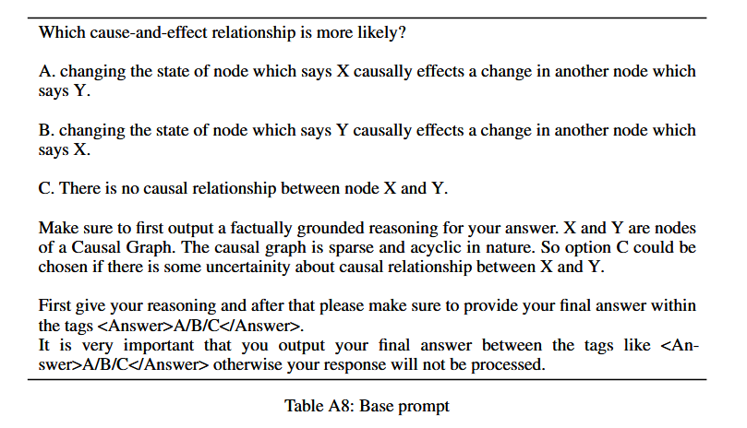
ATAI
Advanced Technique of Artificial Intelligence
ATAI
ChongqingUniversity _{AdvancedTechniqueof}
of Technology Artificial Intelligence
Chongqing University of
Technology
Chongqing University ^{ATAI}
_{of Technology} Advanced Techniqueof
Artificial Intelligence
Chongqing University of Technology
Chongqing University of Technology
Method

Slide 6
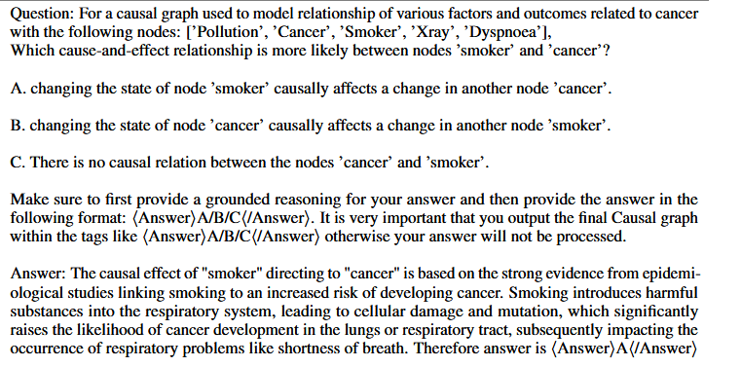
ATAI
Advanced Technique of Artificial Intelligence
ATAI
ChongqingUniversity _{AdvancedTechniqueof}
of Technology Artificial Intelligence
Chongqing University of
Technology
Chongqing University ^{ATAI}
_{of Technology} Advanced Techniqueof
Artificial Intelligence
Chongqing University of Technology
Chongqing University of Technology
Method

Slide 7
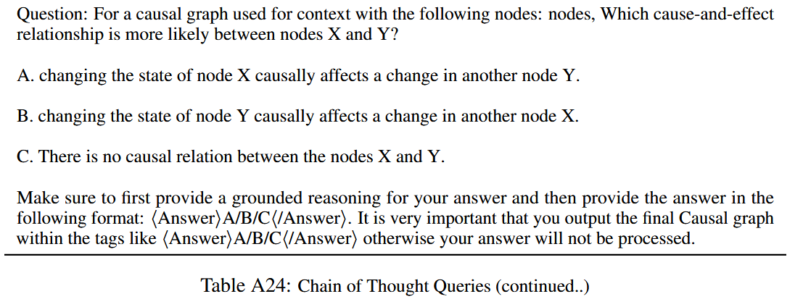
ATAI
Advanced Technique of Artificial Intelligence
ATAI
ChongqingUniversity _{AdvancedTechniqueof}
of Technology Artificial Intelligence
Chongqing University of
Technology
Chongqing University ^{ATAI}
_{of Technology} Advanced Techniqueof
Artificial Intelligence
Chongqing University of Technology
Chongqing University of Technology
Method

Slide 8
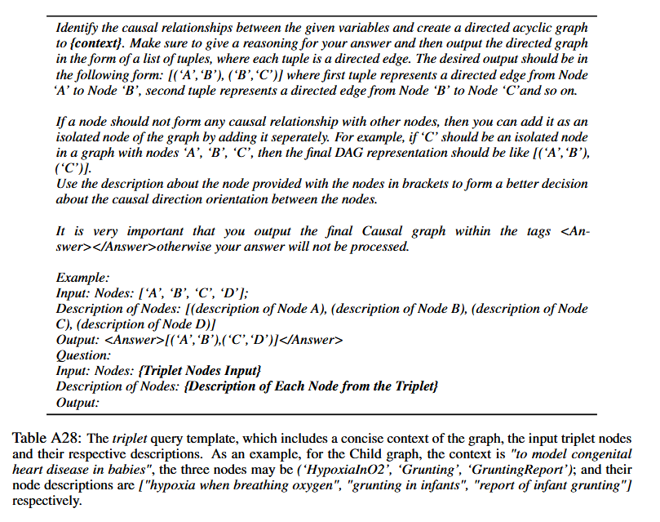
ATAI
Advanced Technique of Artificial Intelligence
ATAI
ChongqingUniversity _{AdvancedTechniqueof}
of Technology Artificial Intelligence
Chongqing University of
Technology
Chongqing University ^{ATAI}
_{of Technology} Advanced Techniqueof
Artificial Intelligence
Chongqing University of Technology
Chongqing University of Technology
Method

Slide 9

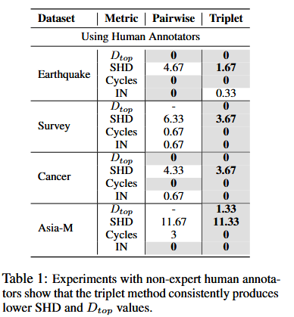
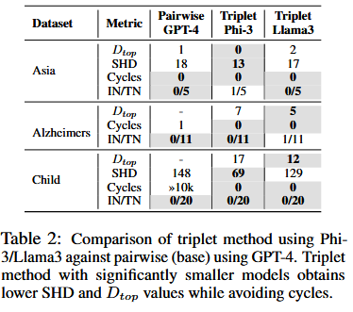
ATAI
Advanced Technique of Artificial Intelligence
ATAI
ChongqingUniversity _{AdvancedTechniqueof}
of Technology Artificial Intelligence
Chongqing University of
Technology
Chongqing University ^{ATAI}
_{of Technology} Advanced Techniqueof
Artificial Intelligence
Chongqing University of Technology
Chongqing University of Technology

Slide 10
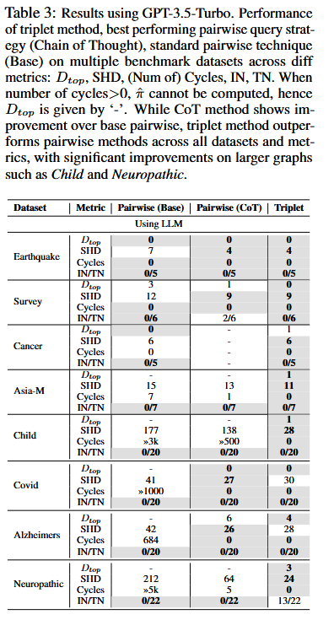
ATAI
Advanced Technique of Artificial Intelligence
ATAI
ChongqingUniversity _{AdvancedTechniqueof}
of Technology Artificial Intelligence
Chongqing University of
Technology
Chongqing University ^{ATAI}
_{of Technology} Advanced Techniqueof
Artificial Intelligence
Chongqing University of Technology
Chongqing University of Technology

Slide 11
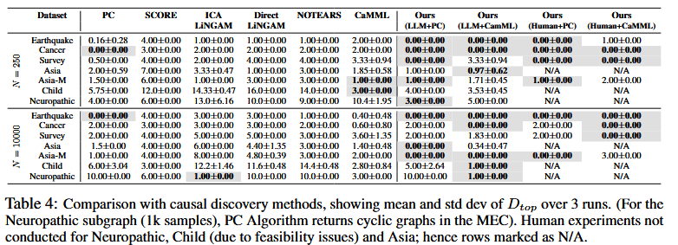
ATAI
Advanced Technique of Artificial Intelligence
ATAI
ChongqingUniversity _{AdvancedTechniqueof}
of Technology Artificial Intelligence
Chongqing University of
Technology
Chongqing University ^{ATAI}
_{of Technology} Advanced Techniqueof
Artificial Intelligence
Chongqing University of Technology
Chongqing University of Technology

Slide 12
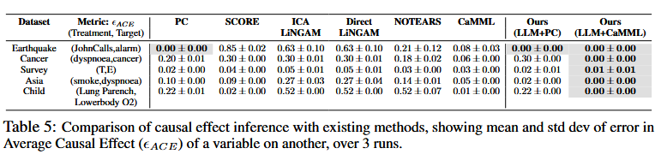
ATAI
Advanced Technique of Artificial Intelligence
ATAI
ChongqingUniversity _{AdvancedTechniqueof}
of Technology Artificial Intelligence
Chongqing University of
Technology
Chongqing University ^{ATAI}
_{of Technology} Advanced Techniqueof
Artificial Intelligence
Chongqing University of Technology
Chongqing University of Technology

Slide 13
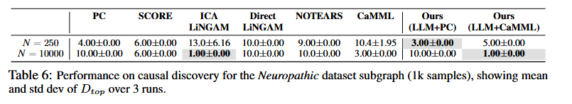
ATAI
Advanced Technique of Artificial Intelligence
ATAI
ChongqingUniversity _{AdvancedTechniqueof}
of Technology Artificial Intelligence
Chongqing University of
Technology
Chongqing University ^{ATAI}
_{of Technology} Advanced Techniqueof
Artificial Intelligence
Chongqing University of Technology
Chongqing University of Technology

Slide 14


ATAI
Advanced Technique of Artificial Intelligence
ATAI
ChongqingUniversity _{AdvancedTechniqueof}
of Technology Artificial Intelligence
Chongqing University of
Technology
Chongqing University ^{ATAI}
_{of Technology} Advanced Techniqueof
Artificial Intelligence
Chongqing University of Technology
Chongqing University of Technology
Thanks!

